Slide 1

Introduction to MongoDB
22 march 2022 by Bechir Brahem

Slide 2
Course outline:
Database concepts
Introducing Mongodb
CRUD operations
Replication & Sharding
MongoDB with python

Slide 3
Database concepts

Slide 4
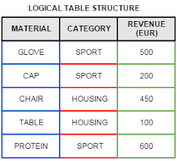
Relational databases
They are databases that follow the relational model to represent data.
The relational model proposed in 1970 stores the data in tables for example student table. And each table has columns for example the student table has name, age, student id… as its columns

Slide 5
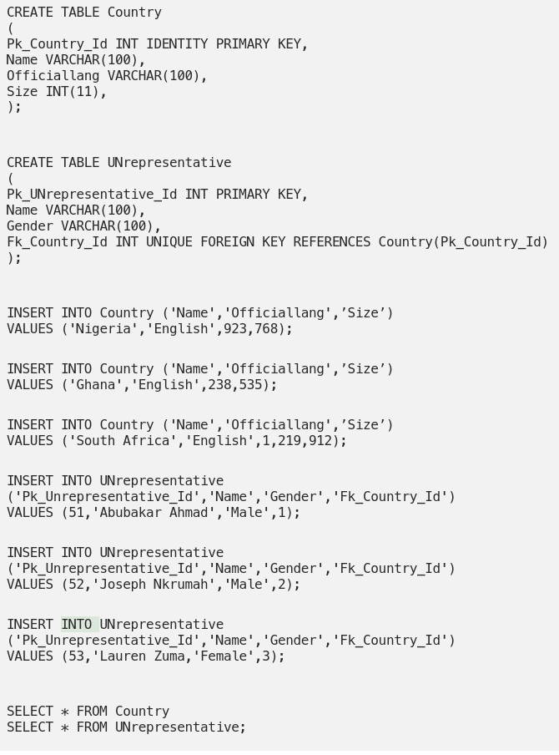
To query over a relational database we use SQL “structured query language” which is a standardized programming language used to:
Read
Write
Update
Delete
Add users
Import and export data
…

Slide 6
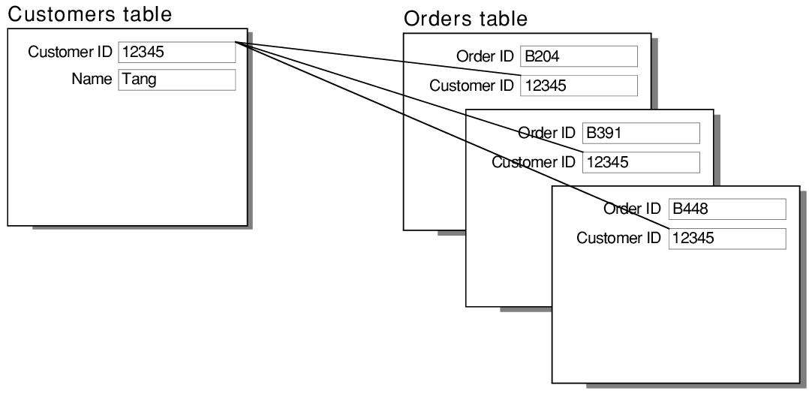
We have customer table and orders table
A customer can have many orders
An order only has one customer
This relationship is called “one-to-many”
To model it we store the customers ID in each order

Slide 7
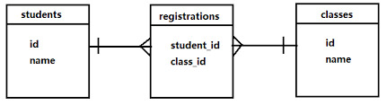
Many to many relationship
A student can have many classes
A class can have many students
To represent this type of relationship we must create a third table. We call this table the join table. This table contains the student_id and class_id.

Slide 8
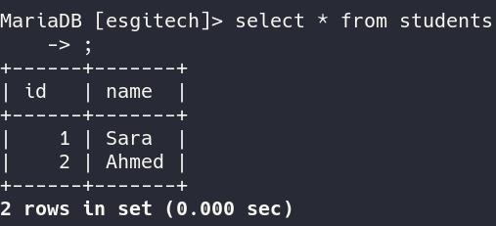
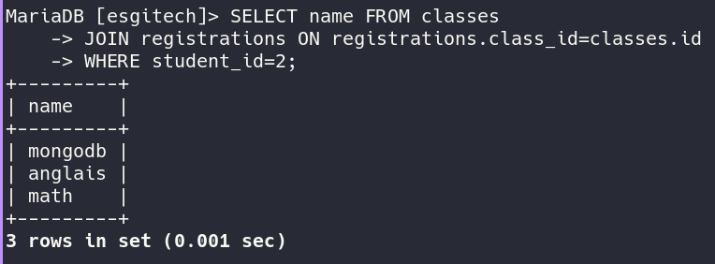
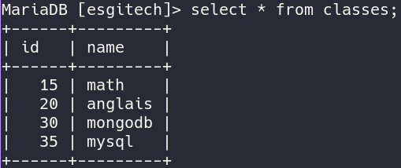
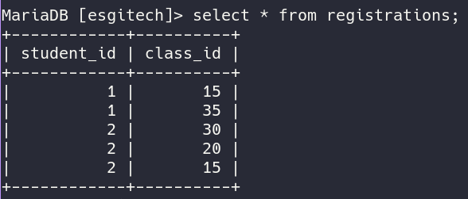

Slide 9




Examples of RDBMS
RDBMS: relational database management system
MySQL, PostgreSQL, MsSQL (microsoft sql server), Oracle database server

Slide 10
Problems with RDBMS
Benefits of RDBMS
RDBMS Are Not Designed To Handle Change
Querying data with JOIN can be very slow
Scaling is very difficult
Database design is very limited
Have been around for decades: have a big community and are very stable
It is cheaper to provision RDBMS databases on the cloud
High consistency
High security

Slide 11
Database properties
ACID principles
Atomicity means that you guarantee that either all of the transaction succeeds or none of it does. You don’t get part of it succeeding and part of it not. If one part of the transaction fails, the whole transaction fails. With atomicity, it’s either “all or nothing”.
Consistency This ensures that you guarantee that all data will be consistent. All data will be valid according to all defined rules, including any constraints, cascades, and triggers that have been applied on the database. Isolation Guarantees that all transactions will occur in isolation. No transaction will be affected by any other transaction. So a transaction cannot read data from any other transaction that has not yet completed. Durability means that, once a transaction is committed, it will remain in the system – even if there’s a system crash immediately following the transaction. Any changes from the transaction must be stored permanently. If the system tells the user that the transaction has succeeded, the transaction must have, in fact, succeeded.

Slide 12

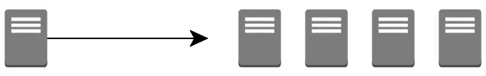
Vertical Scalability
Horizontal Scalability
Scaling vertically (scaling up) means adding more resources such as CPU,RAM… to the instance
Scaling horizontally (or scaling out) means adding more computer instances and distributing tasks across these different instances

Slide 13
Scaling vertically is easier to do and to maintain. Because it does not add any complexity to the existing architecture. But at some point we can no longer scale vertically because there is no existing cpu that can handle that workload. Or it becomes very expensive to buy the latest cpu,ram,ssd components.
Example: on average
Buying 8GB GPU is around 200$ to 500$
Buying 16GB GPU is around 1200$ to 1700$
Not only price is the limit but sometimes there doesn't exist 64 GB GPU
The solution is to distribute the work across many different computers: scaling horizontally.

Slide 14
What is NoSQL?
NoSQL are databases that don’t use SQL and are not relational databases. These databases are used generally to focus on speed, scalability, and availability and dropping strict consistency rules.
These databases are very popular and are used heavily in big data applications, web application, social networks, financial services… and they have very varied specifications

Slide 15
Types of databases
Must use SQL
RDBMS: mysql, postgresql…
NoSQL
Key value store: redis, dynamoDB(AWS)...
Columnar database: cassandra, hbase…
Document database: mongodb…
Time Series database: influxdb…

Slide 16

II. Introducing MongoDB

Slide 17
What is mongoDB
MongoDB is an open-source document database built for horizontal scalability that uses a flexible schema for storing data. Founded in 2007, MongoDB has a worldwide following in the developer community.
mongodB is very prominent for its ease of use, performance, and especially scalability.

Slide 18
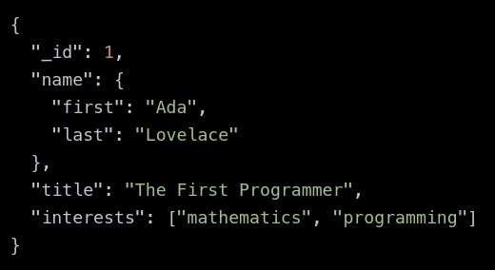
Instead of storing data in tables of rows or columns like SQL databases, each record in a MongoDB database is stored as a document in a collection.
A document is represented in JSON format.
A document can contain arrays, subdocuments, arrays of subdocuments…

Slide 19
Reasons to choose MongoDB
Flexibility: mongodb is very flexible. It does not have a strict schema. Documents have subdocuments and arrays. This makes developing projects in mongodb easier as it requires less planning and shortens the time to market
Highly scalable
High availability
Ease of use
Huge community and support

Slide 20
Setup mongoDB
On windows:
https://docs.mongodb.com/manual/tutorial/install-mongodb-on-windows/
On Mac:
https://docs.mongodb.com/manual/tutorial/install-mongodb-on-os-x/
On linux:
Figure it out yourself

Slide 21
Connect to mongodb
With mongosh
With mongo

Slide 22
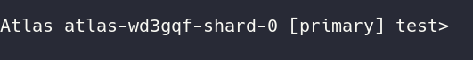
This is the mongo shell where we enter our commands and the mongo server will return responses
Mongodb can have many databases that are separated from each other.
Each database contains many collections. And every collection has many documents.
In RDBMS, a collection is the equivalent of a table. And a document is the equivalent of a record in the table

Slide 23
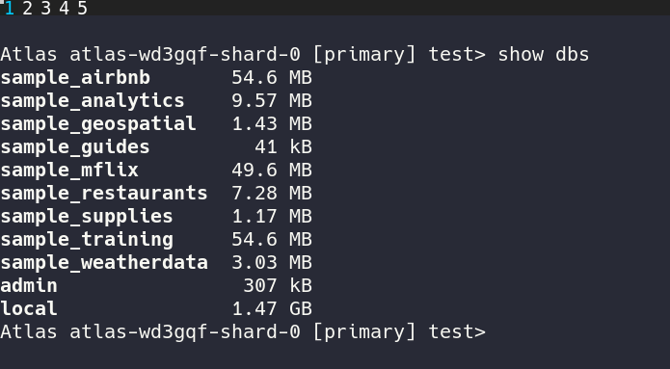
“show dbs” command returns a list of all available databases created in the server

Slide 24
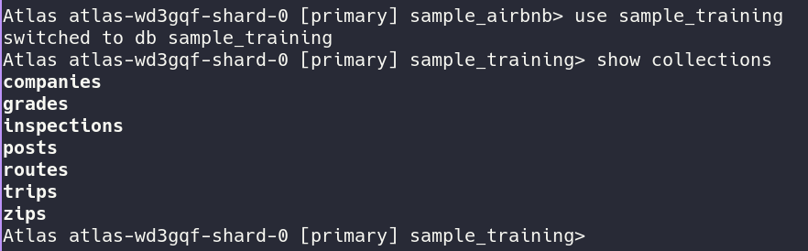
“Use <dbname>” switches to that db
“show collections” prints all available collections in <dbname>

Slide 25
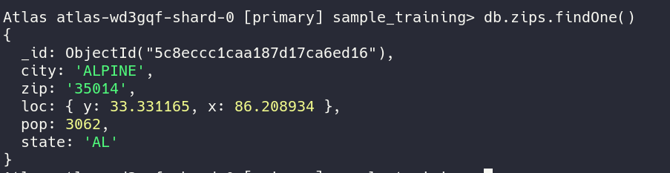
To view one document in the collections we use:
“db.<collection name>.findOne()”

Slide 26
To represent the data, internally, mongodb uses a format called BSON (binary JSON).
Parsing JSON text is slow so for this reason mongodb converts the JSON data to binary for more performance gains. BSON is not humanly readable. Also BSON offers the possibility to add more types such as dates, geospatial data…
We can import and export mongodb data in json or in bson:
For BSON we use: mongodump and mongorestore
For JSON we use: mongoexport and mongoimport

Slide 27
III. CRUD operations

Slide 28
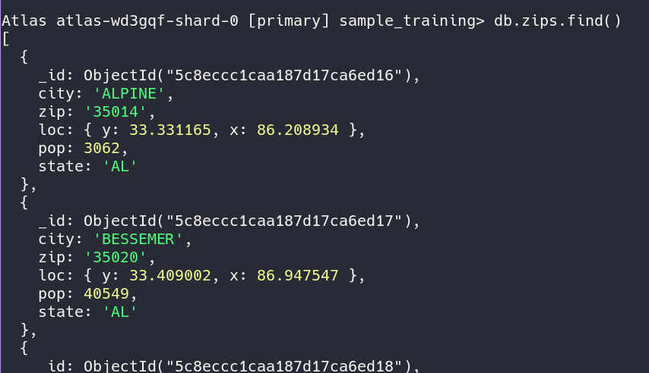
CRUD operations
Create, Read, Update, Delete
“db.<collectionName>.find()”
Returns an array of all available documents.
In the shell it displays only a part of the result (20 documents) we can see more using the command “it”

Slide 29
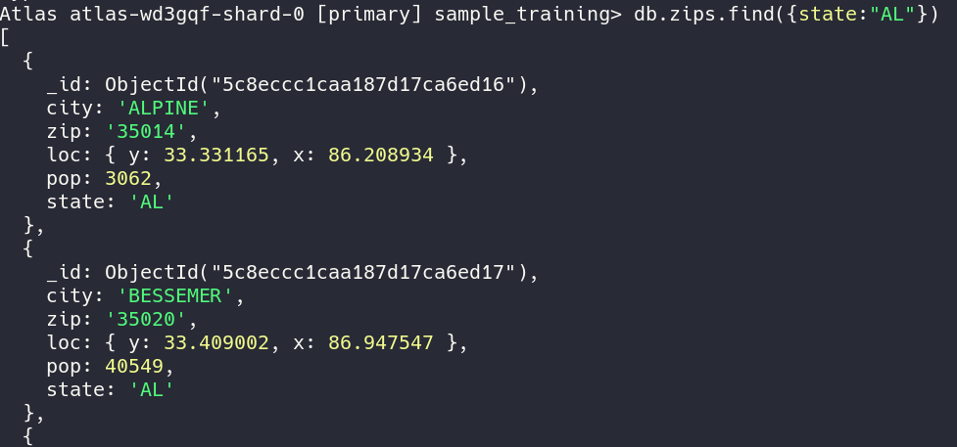
Read
To search using a condition on a specific field we use this syntax

Slide 30
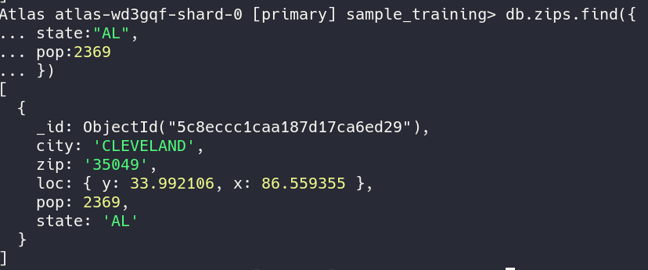
Read
We can have multiple conditions
This query searches for zips that have: state=”AL” and pop=2369

Slide 31
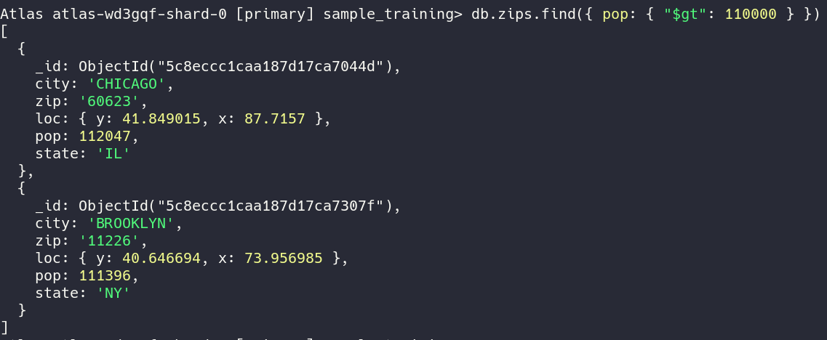
Read
We can also search using comparison operators:
$gt for greater than, $lt for less than , $gte for greater than or equal, $lte for less than or equal, $ne for not equal

Slide 32
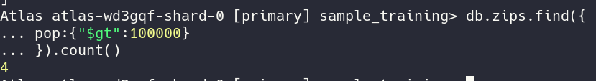
Read
We can also use the “.count()” to know how many documents adhere to that condition.

Slide 33
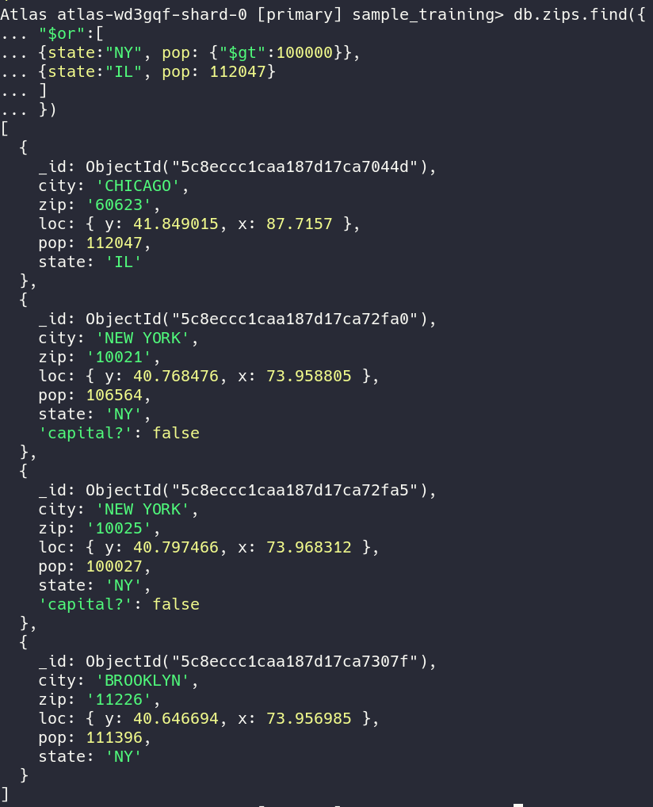
Read
We can also use logic operators like: and, or, not,nor

Slide 34
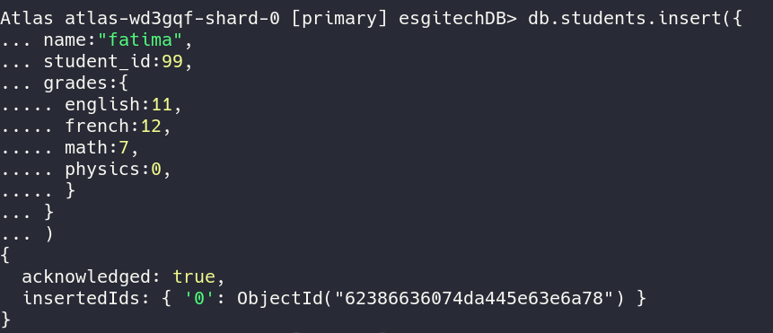
Create
To insert a document in a collection we use:
“db.<collectionName>.insert(<document>)
The document schema is not important. We can have any field name we want.
A document can have subdocuments like grades in this example
If the collection name does not exist. A collection with that name will be created and the document will be inserted in it

Slide 35
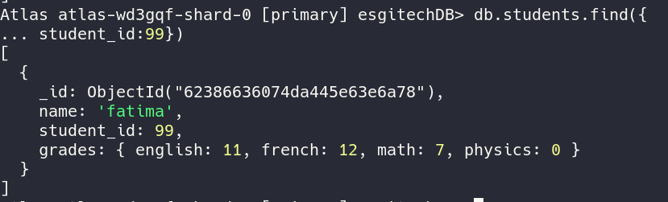
Create
Insert operation automatically create a field name _id that is a unique reference to that document. The _id field has a type of ObjectId

Slide 36
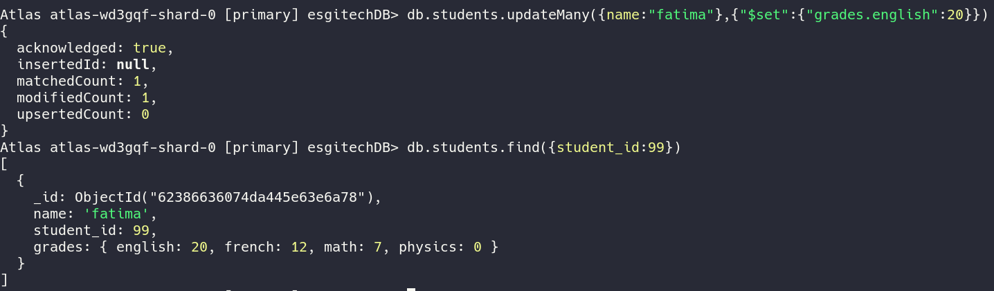
Update
Update query has the following structure:
db.<collectionName>.updateMany({documents to be updated},{“$set”:{<field to update>:value} } )

Slide 37
Update
There are various operators that are used to update documents:
$set: specifies the exact value
$inc: increases the existing field by a value
$mul: multiplies
$min: updates the field to value specified if it is less than this value
$max: same as min but for greater values

Slide 38
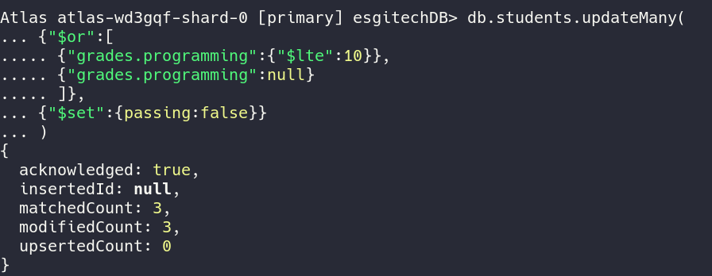
Complex example for update

Slide 39
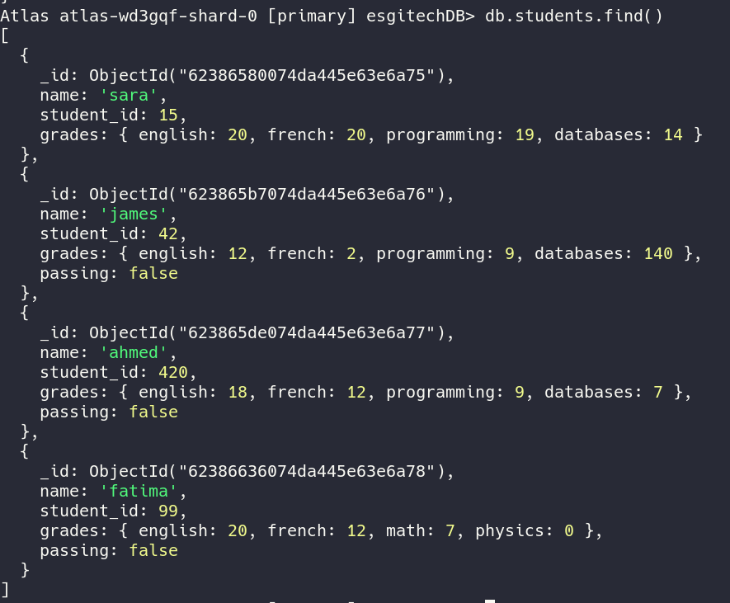

Slide 40
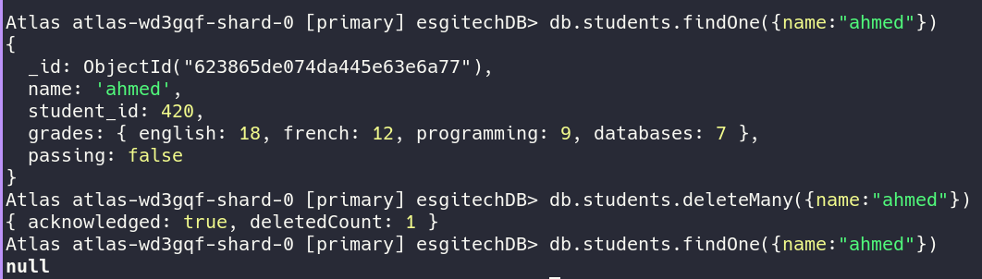
Delete
db.<collectionName>.delete({conditions of documents to delete})

Slide 41
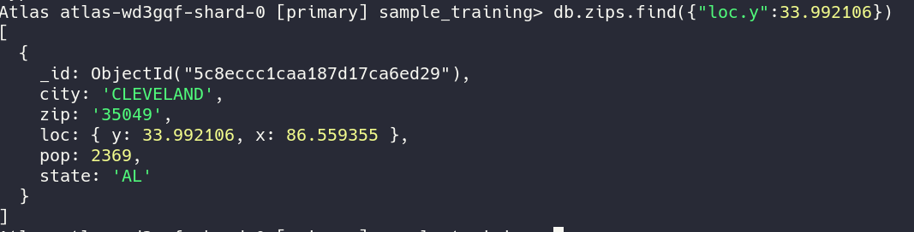
In the next part we will see how to query over arrays and subdocuments:
To reference a field in a subdocument we use the “.” (dot) for example to find the grade english of a student we write “grades.english”

Slide 42
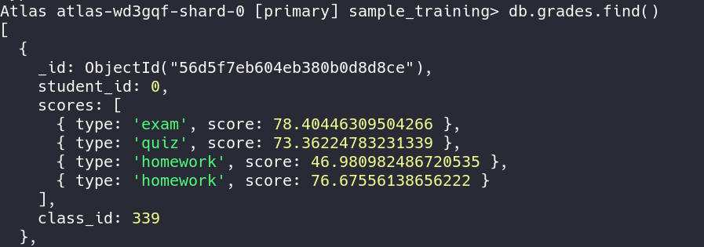
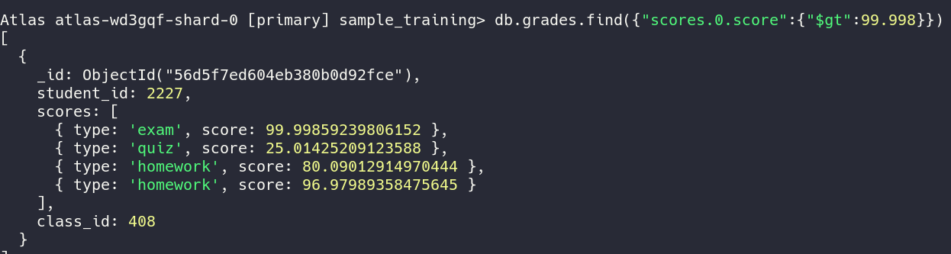

Slide 43
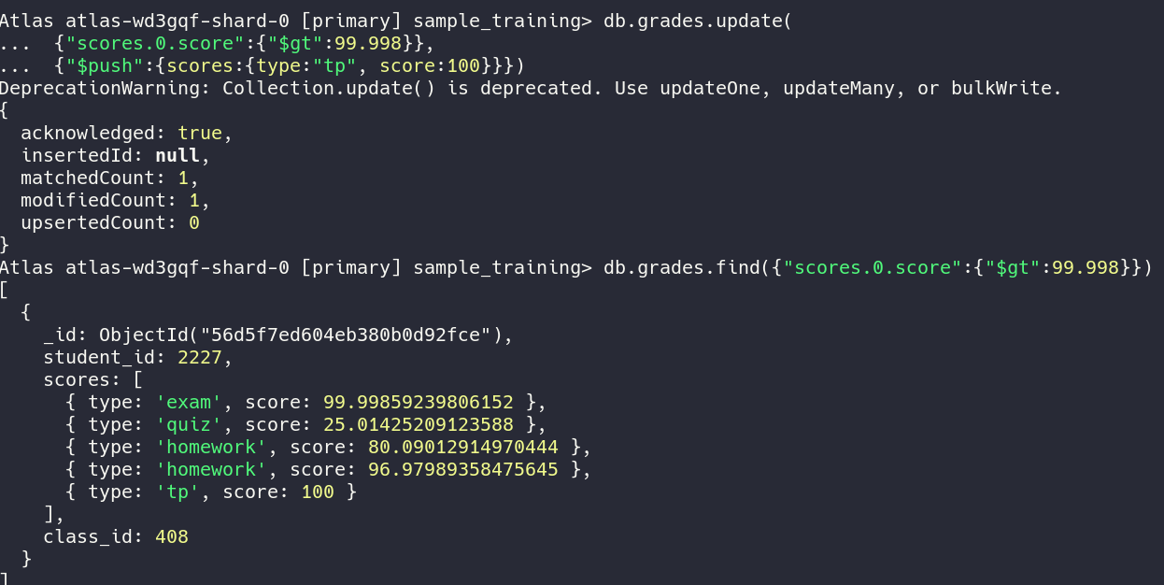
To add an element in an array we use the $push operator
To add an element in an array we use the $push operator

Slide 44
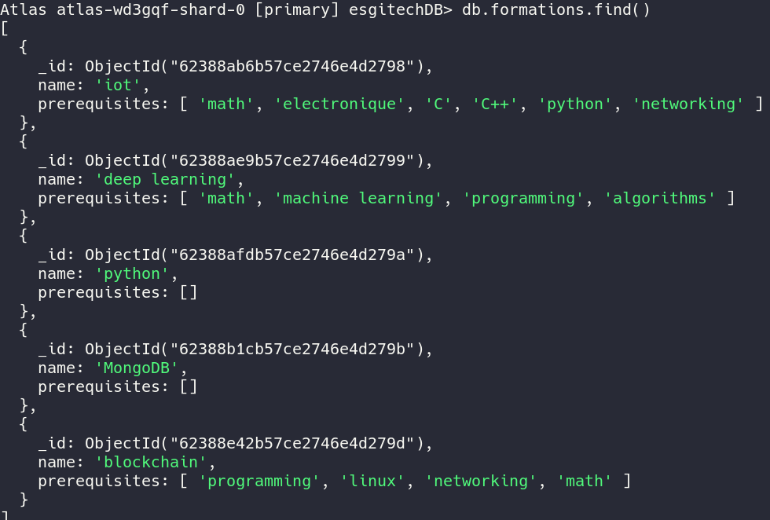
Consider we have this collections about courses and their prerequisites

Slide 45
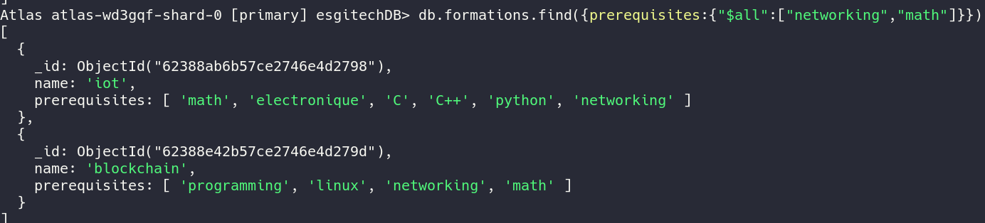
To find all documents that contain both “networking” and “math” in their array prerequisites we use the following query

Slide 46
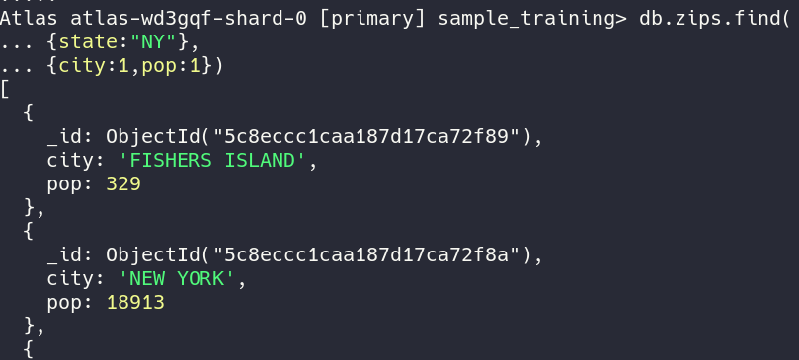
Projection
We can select the fields that we want to receive when we use the find command
The _id field is included by default. We can add “_id:0” to hide it
We can also choose fields that we want to hide by attributing 0 to them

Slide 47
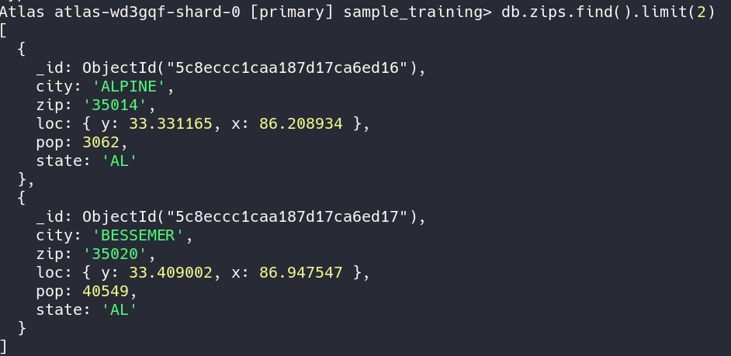
LIMIT
To only show a specified number of documents we use the .limit

Slide 48
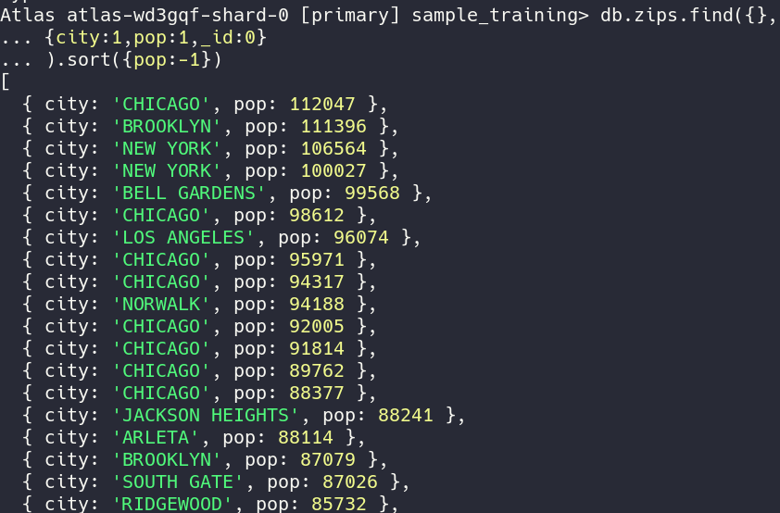
SORT
To sort documents we use the “.sort()” command
Inside the sort() we specify what are the fields we are going to sort on
1 means ascending sort
0 means descending sort

Slide 49
IV. Replication & Sharding

Slide 50
REPLICATION
to achieve high availability we replicate the primary server's data on other servers that acts as secondary nodes to it.
for a cluster of three nodes that are in the same replicaset one node is primary which receives write operations then it transmits them to the other replicas.
when a server goes down the secondary servers perform an election to see who will become the new primary server.
write operations will not be executed until the election is completed
for each server we can set:
priority: which represent how likely this server will become primary
votes: number of votes it has (0 will make it an arbiter)

Slide 51
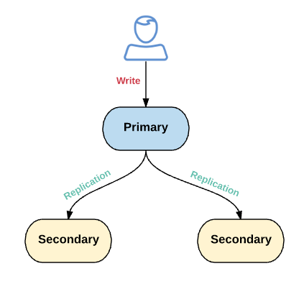

Slide 52
Sharding
when the workload on the database grows we can only scale it vertically up to a certain limit. scaling vertically is very expensive so we another alternative is to scale horizontally.
sharding means splitting the data into many chunks according to some index for example
0<=price<5 and 5<=price<10 and 10<=price<15. after this we deploy each chunk on a different server called a shard. finally when we receive read query that has price=3 we redirect it to the first chunk and so on.
sharding can save a lot of workload on a single node server and allows for better scalability
for mongodb the sharding is implemented with three components:
the router called mongos which redirects queries to the specific server.
the config servers which contains information about the keys and users and other metadata
the shards which are mongod processes and every server (except mongos) will be replicated for high availability in its own replicaset

Slide 53
